Slide 1
Internet Society (South Africa) INETCT 2010
Alan Levin
Chairman

Slide 2
Contents
What next ….. ‘rejuvenate the chapter’
Where we’re coming from
Where are we now?
What next?
We examined these questions and came up with this programme ….

Slide 3
Why INET?
Regional conferences, supported by ISOC
Dawit Bekele approached me last year and we agreed to look at an agenda, which lead us down a path of asking, what next?
A suggested goal was to ‘rejuvenate the chapter’, it resonated… still what next?
Thanks to everyone that helped put it together
Help us to answer it

Slide 4
Policy existence
2001, comments on new Telecommunications Policy Directions
2002 submission on the proposed ECT Bill
2004 response to the draft Convergence Bill
letter to ICASA and DOC to discuss the high cost of bandwidth in South Africa

Slide 5
“For everyone”
Internet connectivity in SA is too expensive
So the majority of the population loses out on access to the wealth of information and the social benefits of joining the information society
Without any knowledge of what it is, demand cannot develop, once exposed, people can see why they should use it and what it can do for them
Internet Society must keep this alive

Slide 6
More…
Response to ICASA document on ADSL Regulation (Released October 13)
Again 2005 – January and Orally in April
2005 April - Response to Convergence Bill
2005 Oct - Position Paper on Internet costs
2006 - Response to ICASA Frequency Spectrum Questions
Friday 29 August 2008 – Altech landmark case

Slide 7
Remember….
Sept 2004: Minister makes a speech - VANS can self-provide infrastructure from Feb 2005 Feb 2005: The day before the policies and regulations come into effect, Minister decides to issue a 'clarification' of her '04 announcement. She didn't mean to imply that VANS can self-provide
2008 : Pretoria High Court (Acting Judge Davis) says minister cannot undo what she said, basically

Slide 8
So…
We have over 400 IECNS licensees
Any number e.g. 200 class ECNS licensees
About 350 IECS licensees
Each of these can obtain right of way, spectrum licensing, use open spectrum and access wholesale Internet connections
Everything we asked for was given to us (in court, and not in any policy hearings)

Slide 9
Basic costs
Basic model - line + transit
Fixed monthly to Telkom – 384/512/4096 dsl
Competitive transit providers – new products all the time, all you can eat, afrihost, mweb…
BUT to quality one must have a Telkom line R131 (i.e. Telkom account + dsl line + transit)

Slide 10
adsl policy and prices
No fixed IP, a for asymmetric, increasing speed
Mid-range 384/128 kbit/s offering since 2005
Real line costs (unchanged since 2002!):
R152 + R131 = R283 for 384/192
R413 + R131 = R545 for 4 Mbps
R326 + R131 = R457 for 512 kbps

Slide 11
Transit
From R29 per GB to R120 (Telkom unshaped)
AND
Fixed price uncapped from MWEB and copycats – R199 (384kbps) to R499 (4Mbps)
Options for all types of users – over 20 qualities of service let’s look at what it takes

Slide 12
IPC - Telkom
Allows a network to terminate all adsl connections, provide Internet transit over your own links
R1m per Gbps per month
1Gbps = 1024 Mbps = 252 (1:1) x 4 Mbps
At cost R1m / R499 = 2000:1 ratio = 64 kbps
64 kbps x 20 = 1280 kbps = 1.25 Mbps

Slide 13
IPC issues
R1m per Gbps per month
1Gbps = 1024 Mbps = 252 (1:1) x 4 Mbps
At cost R1m / R499 = 2000:1 ratio = 64 kbps or really <20
Dealing with contention and shaping is part of developing an Internet network. We have well over 24 (different qualities of) adsl in SA today
Other than IPC, the transit costs form the balance of the network costs

Slide 14
Consumer Lines
Telkom adsl – R545 line only (unchanged since 2002) - incumbent local loop unbundling still on the cards
Other options available
Neotel, iburst
3.5g HSDPA+
Fixed license free spectrum wireless
Spectrum allocations still on the cards

Slide 15
Belhar Internet Fiesta

Slide 16
Taxi TRUCK
Announced last week
R3 per trip increase, R264 / month (2 trip route)
Less than R545 and R283
Prepaid 3g and other innovative last mile solutions possible – but limited by the same challenge
The last mile, innovation must happen and has, for example 3G – HSDPA+
Indeed the transit, lets look at those costs

Slide 17
ISP network
IPC lands at a central location (known also as Bitstream) – last mile
Backhaul / transit network
Local connections – metropolitan – for peering, between data centre’s
National – inter-city connections
International – across the oceans to the rest of the internet

Slide 18
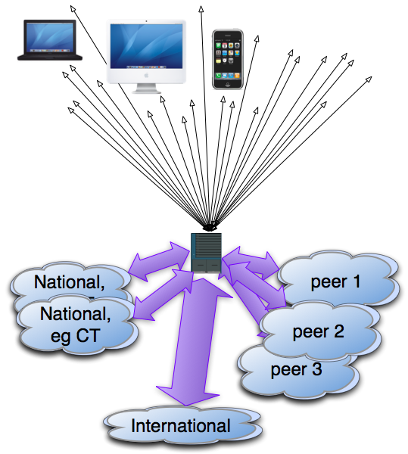
Transit essentials
Last Mile
(IPC model)
Transit or backhaul network

Slide 19
Last mile – alt IPC
We’ve really innovative mobile networks, HSDPA+ is a good investment
Fixed wireless networks offer globally routed address space over speeds up to 50Mbps (faster than backhaul)
FTTH is done on campus level
LLU and spectrum licensing – skeptical
Can we expect lower costs? R540 for 4Mbps >> R0

Slide 20
What next?
ISOC-ZA
ICASA, DOC
Municipalities
ISPs
Gigabit providers
Can we expect lower prices?

Slide 21
Transit cost to ISP
International, 2002-2010 (adsl not changed), wholesale has gone from >R25k per Mbps to R5k per Mbps (on STM1-155.520 Mbps in Jhb or CT)
National from R10k to R2k per Mbps (on 155.520 Mbit/s Jhb to CT, metropoles only)
Local, from R1 per Mbps per month

Slide 22
map

Slide 23
map
Notes:
dynamic 2D JPG/PNG images and 3D VRML maps of the Internet. These maps are built off of our database using two different graphing engines: Large Graph Layout (LGL) by Alex Adai and Graphviz by Peter North at AT&T Labs Research

Slide 24
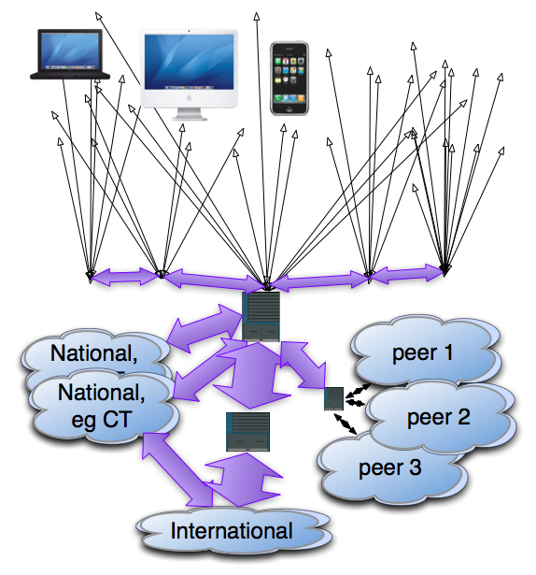
Transit essentials
Last Mile
(IPC model)
Real last mile
60%
Transit network

Slide 25
Transit cost to ISP
International, 2002-2010 (adsl not changed), wholesale has gone from >R25k per Mbps to R5k per Mbps (on STM1-155.520 Mbps in Jhb or CT)
National from R10k to R2k per Mbps (on 155.520 Mbit/s Jhb to CT, metropoles only)
Local, from R1 per Mbps per month (R1,000 per Gbps)

Slide 26
Transit cost to ISP
DFA – Dark Fibre Africa rent unlit point to point fibre on their metropolitan network
Telkom, and Neotel offer gigabit ethernet
City of Durban and City of Cape Town (will) offer the similar product
These are all based on distance. Cape Town offer multiple switching colos.

Slide 27
What next?
Can we expect lower prices? (on transit)
R499 for uncapped 4Mbps adsl
NET transit cost: (4*R5k*0.6)+(4*R2k*0.4)/20 1:20 = R760, 1:40 = R380,
1:20 @1.25Mbps = R237.50
IPC cost: R499
R169 for 500MB prepaid (7.2Mbps)
Net transit cost: product of backhaul links

Slide 28
What next?
Can we expect lower prices?
Not really it seems not on transit nor access,
But we should expect better speeds, and better provisioning on backbones
Where not, do we allow market forces to force customers to change provider or do we educate providers?
How do consumers educate themselves to understand differing quality of service?

Slide 29
Questions
Is LLU and spectrum allocation more important than municipal, provincial and national government subsidised fibre?
What will happen in metropoles with good fibre models?
What are the roles for ISOC-ZA and ISOC?

Slide 30
What next?
Steve Song - African undersea cables
Stefan Doeblin - Chairman, Network Economy
J Scott Marcus - Director, Department Manager for WIK-Consult in Germany
Panel - Internet aggregators - backbone providers - up to Gigabit related products for ISPs
Open microphone – to address the questions
Notes:
Stefan sits on the investment boards of a number of hi-tech companies. He was previously a member of the advisory board of central R&D of Deutsche Telekom. Prior to that Stefan was CEO and one of the two major shareholders of the TIMe-start-up management group, and was MD of MFS Communications in Germany (now part of MCI WorldCom) setting up the first local loop access carrier in competition to Deutsche Telekom (getting special permission from the Regulator to install fibre in several cities, one year before deregulation allowed it, and negotiating the first contract with city authorities in Germany to use their ducts for cabling!)
Before his work at MFS, Stefan was Business Development Manager at British Telecom plc., in charge of acquisitions, strategic alliances and strategic projects (outsourcing, system integration and consulting). Even earlier he worked as senior consultant for Arthur D. Little in client projects at Swisscom, BT and Siemens.
Stefan graduated in Mathematics and Business Administration and Engineering and started his career as a systems engineer at SEL Software GmbH, now part of Alcatel. Stefan has worked around the world and is author of the books “Wie beeinflußt der Kapitalmarkt die Innovation in der Telekommunikation”, published in 2001, “eCompanies, gründen, wachsen, ernten”, published 2000 and "Just in Time bei Software Grossprojekten", published in 1991.
Stefan is an entrepreneur who has contributed to the book “The future of telecommunications industries” By Arnold Picot. This is all the evidence we needed that he is an ideal speaker for the South African community as he has the understanding of an academic but the experience of a venture capitalist. He has agreed to speak at our conference planned May 24, 2010.
Senior Advisor for Internet Technology at the Federal Communications Commission (FCC) in Washington, DC. I worked for the European Commission during 2004 pursuant to a grant from the German Marshall Fund of the United States (GMF). Prior to joining the FCC, I was Chief Technology Officer (CTO) for GTE Internetworking (Genuity).

Slide 31
Gigabit
Should we do more?

Slide 32
INETCT 2010
Thanks to
The wg: Saul, Paul, and Bronwen
Support: Carmen and Stephnie
Sponsors: ISOC!
UniforumSA and DFA
The venue and ALL of YOU!

